Slide 1
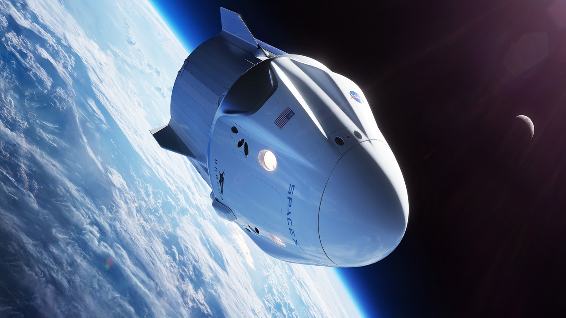

IBM
SPACEX
ROCKET REUSABILITY
MIKE PIATEK
04/20/2023

Slide 2

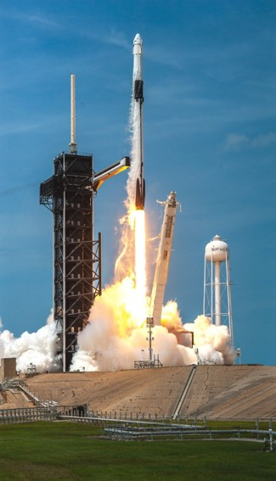
TABLE OF CONTENTS
Executive Summary 2
Introduction 4
Project Procedures 6
EDA Discoveries 16
Launch Site Analysis 30
Plotly Dashboard 34
Predictive Analysis 38

Slide 3

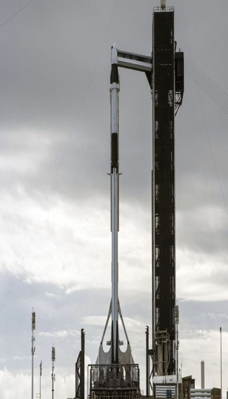
EXECUTIVE SUMMARY
Research aimed to identify factors for successful rocket landings, using the following methodologies:
Data collected via SpaceX API and web scraping​
Data structured for success/fail outcome variable​
Data patterns visualized for payload, launch site, flight number, and yearly trends​
Data analyzed with SQL for total payload, payload range, and success/failure outcomes​
Launch site success rates investigated in relation to geographical markers​
Visualizations created for successful launch sites and payload ranges​
Models built with logistic regression, SVM, decision tree, and KNN algorithms for outcome prediction

Slide 4
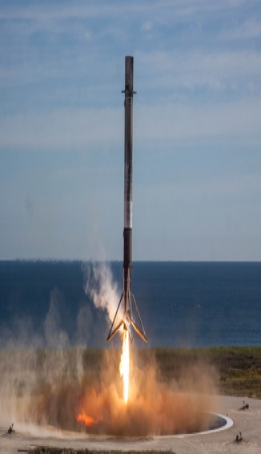
Executive Summary
Summary of Results
Exploratory Data Analysis
Findings suggest improvement in launch success over time
KSC LC-39A demonstrated the highest success rate among all landing sites
Orbits ES-L1, GEO, HEO, and SSO all achieved a 100% success rate
Predictive Analytics
All models showed comparable performance on the test set
Decision tree model outperformed the other models slightly
Visualization/Analytics
Most launch sites are situated near the equator and coastal areas

Slide 5
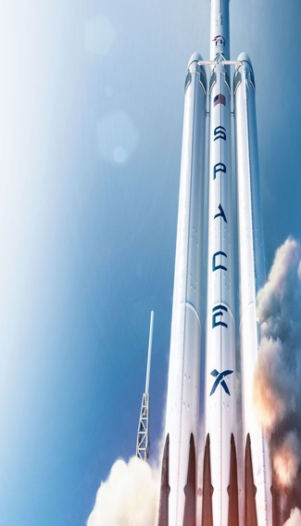
INTRODUCTION
SpaceX is a leading force in making space travel accessible and affordable.
Their impressive track record includes launching satellites for internet access, sending spacecraft to the ISS, and manned missions to space.
How do they keep launch costs at $62 million when competitors charge upwards of $165 million?
By reusing the Falcon 9's first stage, which they can do because they successfully land it.
Predicting a successful landing can determine launch price, and machine learning models and public data can be used for this.
This approach leads to greater pricing accuracy and transparency in the industry.

Slide 6
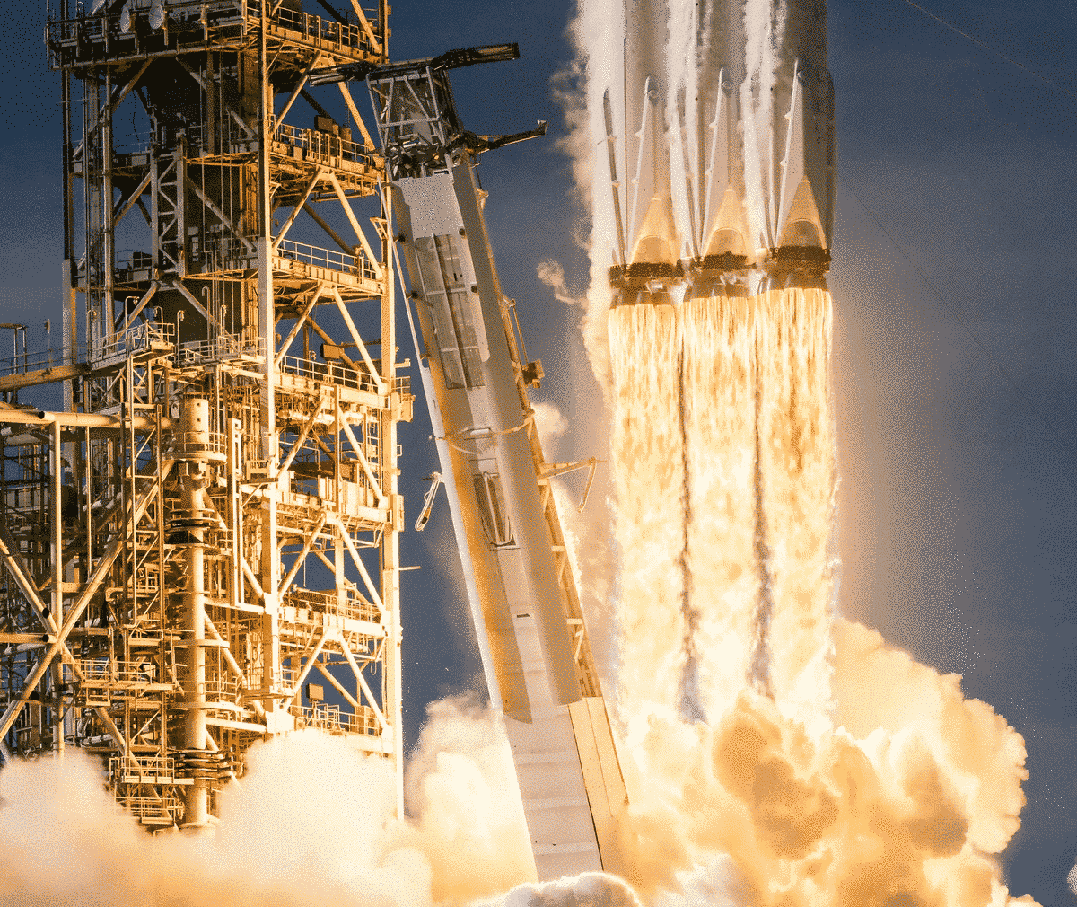
INTRODUCTION
1
Predicted rocket landing success rates in space exploration
2
Explored factors impacting landing success
3
Identified contributing factors and examined success rate trends
4
Determined best predictive model through binary classification
5
Improve space exploration efficiency and contribute to cost-effectiveness
6
Our work supports scientific community's push for expansion

Slide 7
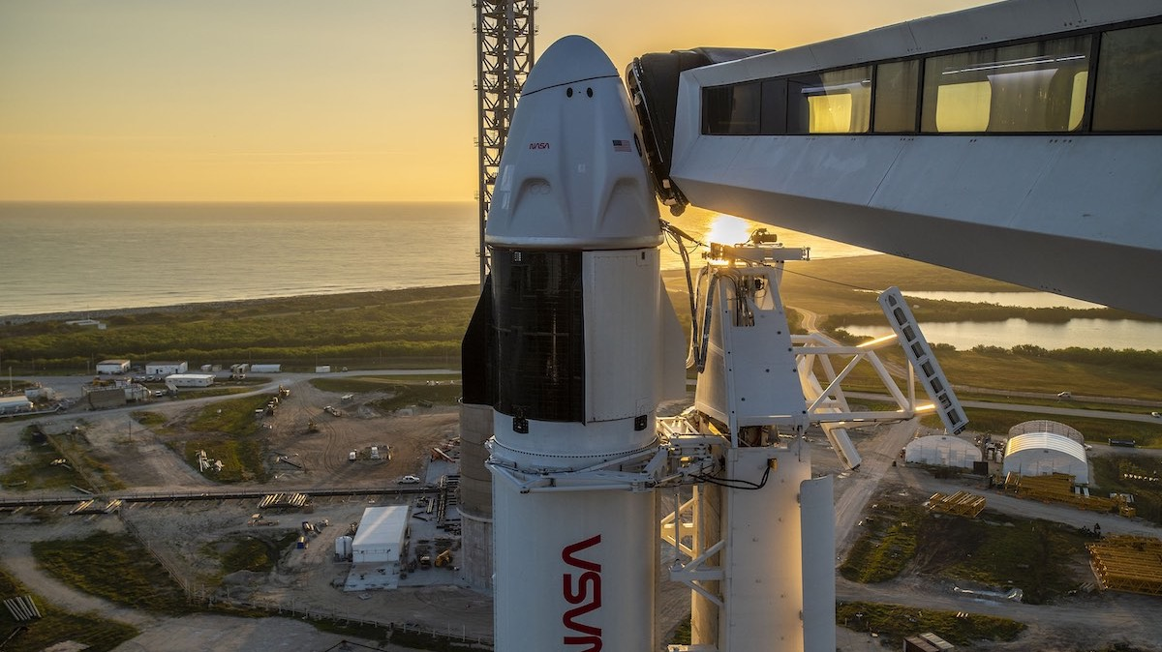
PROJECT PROCEDURES

Slide 8
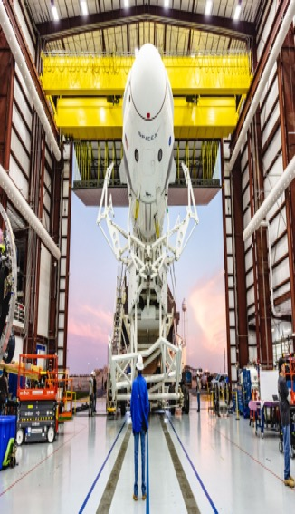





PROJECT PROCEDURES
Collect
Wrangle
Explore
Visualize
Machine Learning
Utilize SpaceX's REST API and advanced web scraping techniques to collect comprehensive data
Streamline the data by filtering and handling missing values, and optimize it for analysis and modeling through the implementation of one-hot encoding
Conduct extensive exploratory data analysis (EDA) using SQL and employ various data visualization techniques to gain valuable insights
Create dynamic and interactive visualizations of the data using advanced tools such as Folium and PlotlyDash
Develop powerful classification models to accurately predict landing outcomes, fine-tuning and evaluating them to determine the optimal model and parameters

Slide 9
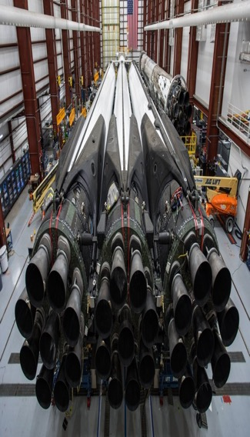

DATA COLLECTION – SPACEX API
Retrieving response from API endpoint
Parsing response to JSON format
Applying customized data cleaning functions
Converting list to dictionary and then to data frame
Filtering data frame and exporting it to a flat file format (e.g., .csv)

Slide 10
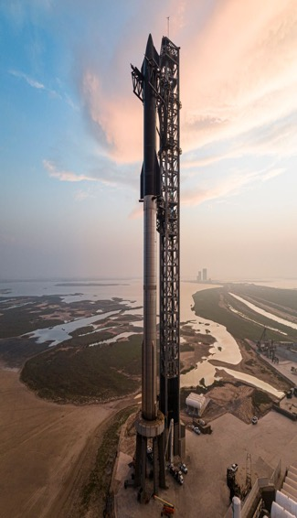
DATA COLLECTION – WEB SCRAPPING
1
2
3
4
5
6
7
8
Retrieving HTML response from server
Instantiating a BeautifulSoup object to parse the HTML response
Locating tables within the HTML response
Extracting column names from the table headers
Creating a dictionary object to hold the table data
Appending data rows to their respective dictionary keys
Converting the dictionary object to a pandas data frame
Exporting the data frame to a .csv file format

Slide 11
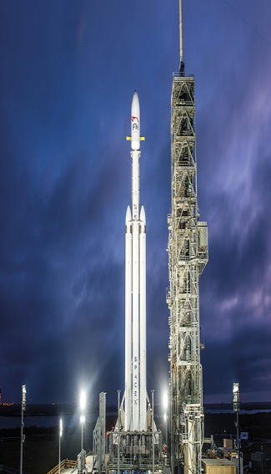
DATA WRANGLING
Landing Outcome
Landing Clarity
Data Wrangling Process
Mission success: Accurately landed in designated ocean region
Conducted an Exploratory Data Analysis (EDA) to determine the appropriate data labels
True Ocean
False Ocean
Mission failure: Unsuccessful landing within ocean region
Calculated number of launches for each launch site
True RTLS
Mission success: Landed successfully on a ground pad
Calculated frequency of orbit occurrence
False RTLS
Mission failure: Unsuccessful landing on a ground pad
Calculated frequency of mission occurrence
True ASDS
Mission success: Successfully landed on a drone ship
Calculated outcomes per orbit type
Mission failure: Unsuccessful landing on a drone ship
Created a binary landing outcome column as the dependent variable to facilitate predictive modeling
False ASDS
Outcomes Converted
Encoding landing outcomes as 1 (successful) or 0 (unsuccessful)
Exported the cleaned and refined data to a CSV file for further analysis and modeling

Slide 12
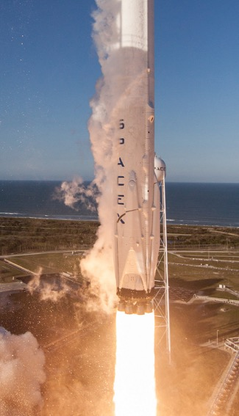


EDA - VISUALIZATION
Throughout the course of the research study, various graphical representations were employed to effectively communicate the data. Specifically, the three types of graphs utilized were bar graphs, line graphs, and scatter graphs, each serving a distinct purpose in visually depicting the findings
Bar Graph
Line Graph
Scatter Graph
Success Rate vs Orbit
Bar graphs are effective for displaying and comparing categorical data
Success Rate vs Year
Line graphs are a preferred method of data visualization due to their ability to effectively communicate trends and patterns over time or across a continuous variable
Flight Number vs Launch Site
Payload vs launch Site
Flight Number vs Orbit
Payload vs Orbit
Scatter graphs are useful for identifying the relationship between two continuous variables

Slide 13
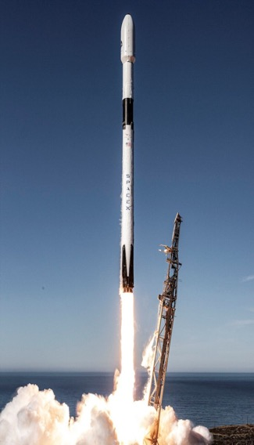
EDA - SQL
Below are the SQL queries that were executed during the course of the project:
1
Displayed
2
Displayed
3
Displayed
a comprehensive list of unique launch sites utilized in the space mission
records of five launch sites beginning with the designated string "KSC"
the total payload mass carried by NASA (CRS) boosters launched
4
Displayed
5
Listed
6
Listed
the average payload mass carried by booster version F9 v1.1
the dates of successful drone ship landing outcomes
the names of boosters achieving success in ground pad with a payload mass greater than 4000 but less than 6000
7
Listed
8
Listed
9
Listed
a tally of the number of successful and failed mission outcomes
the booster versions that have carried the maximum payload mass
records displaying the month names, successful landing outcomes in ground pad, booster versions, and launch site for months in the year 2017
Ranked
10
the count of successful landing outcomes between the dates of 2010-06-04 and 2017-03-20 in descending order

Slide 14
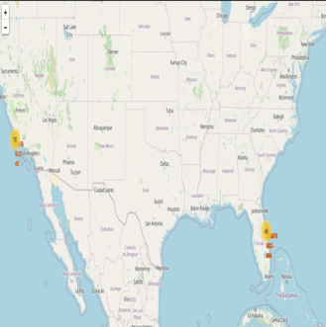
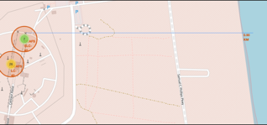
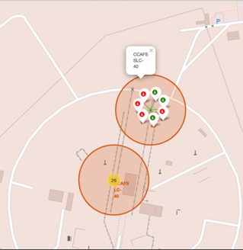
MAP - FOLIUM
Image Two
Questions?
As part of our data visualization efforts, we assigned the launch outcomes of failures and successes to respective classes of 0 and 1. These classes were then visually represented on the map using marker clusters, with green markers denoting successes and red markers indicating failures
Are launch sites in close proximity to railways? No
Are launch sites in close proximity to highways? No
Are launch sites in close proximity to coastline? Yes
Do launch sites keep certain distance away from cities? Yes
Image One
Image Three
In order to visually represent the launch sites, latitude and longitude coordinates were collected and utilized to generate circular markers around each site. Each marker was accompanied by a label indicating the name of the corresponding launch site
In order to gain insights into the surrounding environment of the launch sites, we employed Haversine's formula to calculate the distances to various landmarks. These calculations allowed us to identify trends and patterns in the surrounding area. To visually represent these findings, lines were drawn on the map to illustrate the distances to the corresponding landmarks

Slide 15
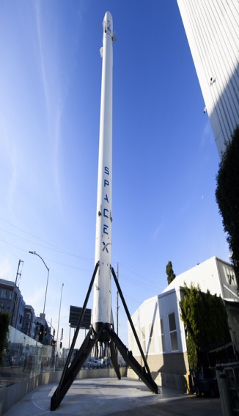
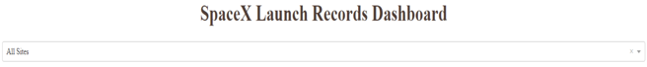
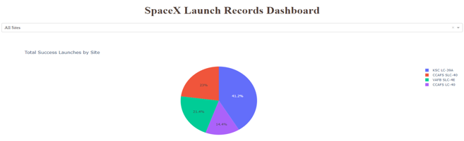
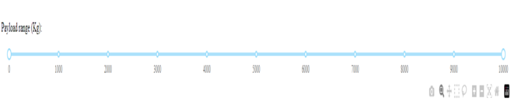
DASHBOARD - PLOTLY
Improve user experience by providing a dropdown list of launch sites, allowing selection of all sites or a specific one
Visualize launch success rates with a pie chart for easy comparison of successful and unsuccessful launches to the total:
Add a slider for payload mass range selection to allow the user to adjust and choose the desired range

Slide 16

PREDICTIVE ANALYTICS
1
2
3
Building Model
Building Model
Building Model
Constructed a NumPy array utilizing the column labeled "class”
Utilizing the Standard Scaler method, both fitting and transforming of the data
Partitioning the Data into Training and Testing Sets
4
5
6
Building Model
Evaluating Model
Evaluating Model
Ran logistic regression with GridSearchCV, showing optimized parameters and validation accuracy with 'best params' and 'best score'
Computed the accuracy score of the test data utilizing the 'score' method
Obtained optimized hyperparameters for each algorithmic type
7
8
9
Evaluating Model
Improving Model
Best Model
Generate a graphical representation of the Confusion Matrix
Conduct Feature Engineering and Refine Algorithmic Models via Tuning
Determine the Optimal Model based on Jaccard Score, F1 Score, and Accuracy Metrics

Slide 17
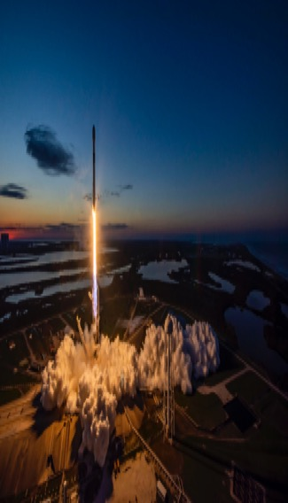



RESULTS SUMMARY
Exploratory Data Analysis (EDA)
The success rate of launches has shown an upward trend with the passage of time
KSC LC-39A is the landing site with the highest success rate, indicating its reliability
Orbits ES-L1, GEO, HEO, and SSO stand out with a 100% success rate, showcasing their exceptional performance
Visual Analytics
Most of the launch sites are situated in close proximity to the equator, with all being located near the coast
The launch sites are carefully chosen to ensure that a failed launch does not cause damage to any nearby structures, such as cities, highways, and railways
However, they are strategically positioned to facilitate the transportation of essential resources and personnel required for successful launch
Predictive Analytics
Based on our analysis, the Decision Tree model has been identified as the optimal predictive model for the given dataset

Slide 18

EDA DISCOVERIES

Slide 19
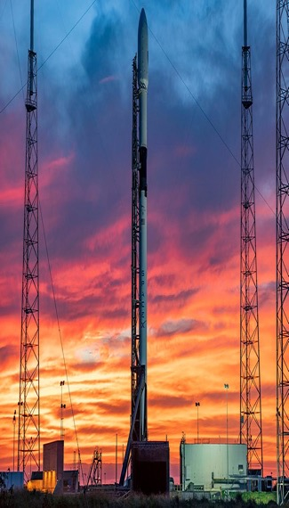
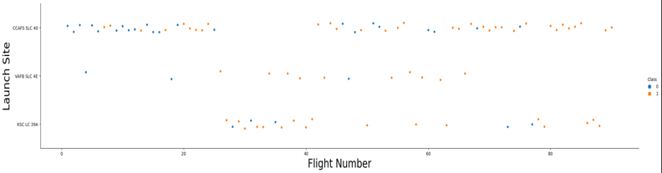
FLIGHT NUMBER VS LAUNCH SITE
Previous flights experienced a lower success rate, as indicated by the blue marking for failure
Approximately 50% of all launches originated from the CCAFS SLC 40 launch site
Based on our observations, we can infer that newer launches are more likely to achieve success
In contrast, subsequent flights demonstrated an increased success rate, as indicated by the orange marking for success
Launches from the VAFB SLC 4E and KSC LC 39A sites exhibited a higher success rate compared to others

Slide 20
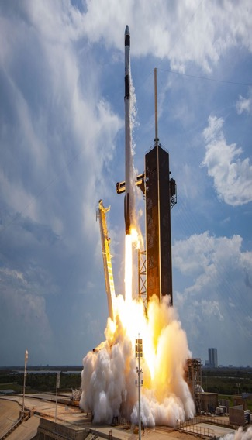
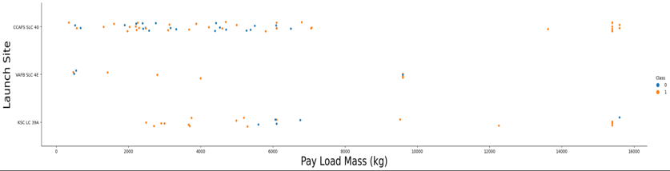
PAYLOAD VS LAUNCH SITE
The majority of launches that carried payloads weighing more than 7,000 kg experienced successful outcomes
In general, there is a positive correlation between the mass of a payload (measured in kilograms) and the likelihood of a successful launch
To date, the VAFB SKC 4E launch site has not conducted a launch with a payload exceeding approximately 10,000 kg
Launches from the KSC LC 39A site with payloads less than 5,500 kg have achieved a 100% success rate

Slide 21
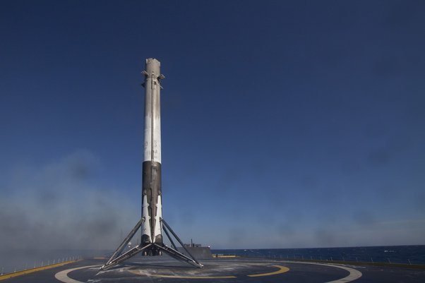
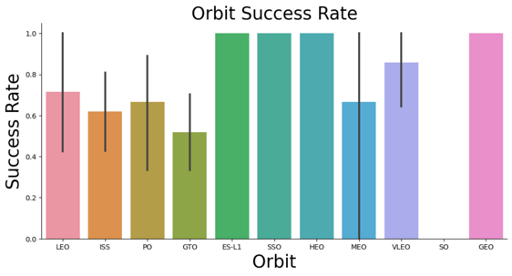
SUCCESS RATE VS ORBIT
100% success rate:
50% - 80% success rate:
0% success rate:
ES-L1
GEO
HEO
SSO
GTO
ISS
LEO
MEO
PO
SO

Slide 22
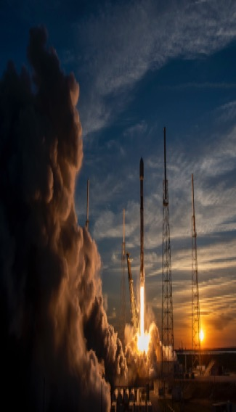
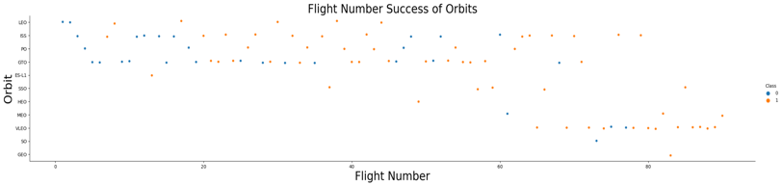
FLIGHT NUMBER VS ORBIT
Generally, as the number of flights for a given orbit increases, there is a corresponding increase in the success rate of launches
However, the Geostationary Transfer Orbit (GTO) does not conform to this pattern, as the success rate is not significantly impacted by the number of flights
This trend is particularly pronounced for the Low Earth Orbit (LEO)

Slide 23
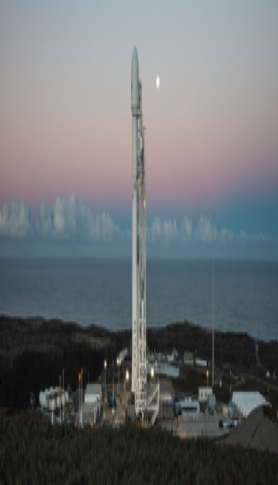
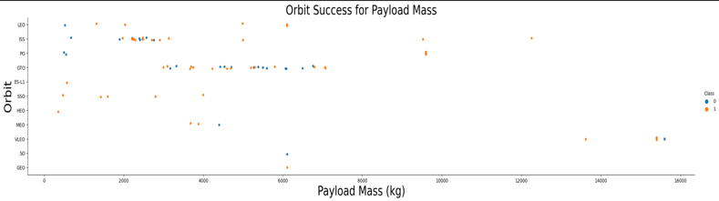
PAYLOAD VS ORBIT
Heavy payloads typically exhibit a higher success rate for launches targeting the Low Earth Orbit (LEO), International Space Station (ISS), and Polar Orbit (PO) trajectories
In contrast, the Geostationary Transfer Orbit (GTO) has demonstrated a mixed success rate for launches carrying heavier payloads
Launches carrying heavy payloads to the LEO, ISS, and PO orbits require precise launch vehicle capabilities to achieve optimal success rates, while launches to the GTO orbit may benefit from additional technological advancements to improve outcomes for heavier payloads

Slide 24
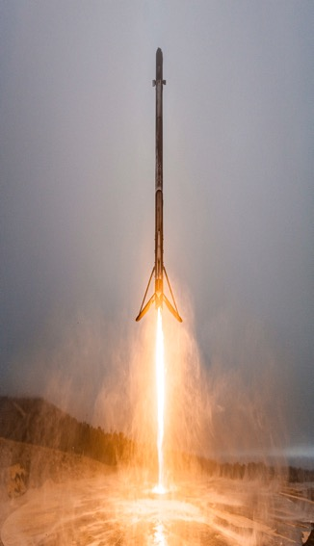
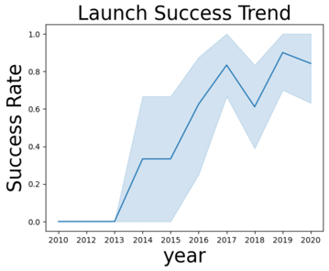
LAUNCH SUCCESS YEARLY TREND
The success rate of launches demonstrated notable improvement during two distinct periods: from 2013-2017 and again from 2018-2019
Conversely, the success rate exhibited a decrease from 2017-2018 and again from 2019-2020
In general, the success rate of launches has demonstrated a positive trend since 2013

Slide 25
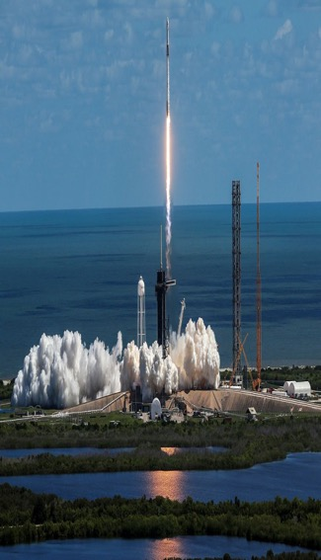
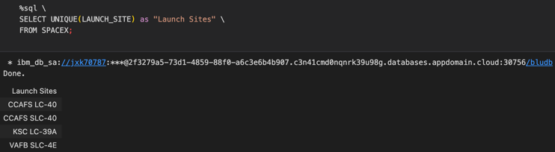
LAUNCH SITE NAMES
Launch Site Names
CCAFS LC-40 - Cape Canaveral Air Force Station Launch Complex 40
CCAFS SLC-40 - Cape Canaveral Air Force Station Space Launch Complex 40
KSC LC-39A - Kennedy Space Center Launch Complex 39A
VAFB SLC-4E - Vandenberg Air Force Base Space Launch Complex 4E

Slide 26
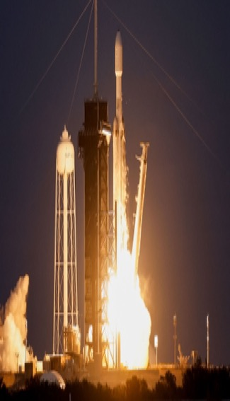
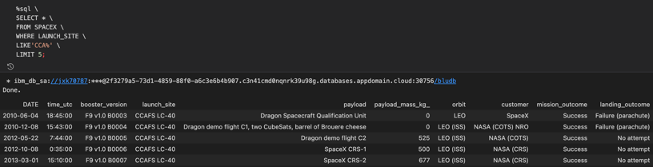
LAUNCH SITE NAMES start with ‘cca’
In our data retrieval efforts, we have successfully obtained a set of 5 records that meet the criteria of having launch sites that begin with the characters 'CCA'. This outcome reflects the effectiveness of our data gathering methods and provides us with valuable information for our research and analysis

Slide 27
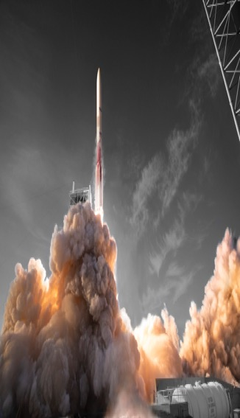
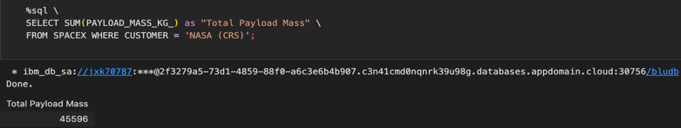
TOTAL PAYLOAD MASS
The Total Payload Mass
Nasa: 45,596 kg
The NASA Commercial Resupply Services (CRS) program launched a total payload mass of 45,596 kg to the International Space Station (ISS)

Slide 28
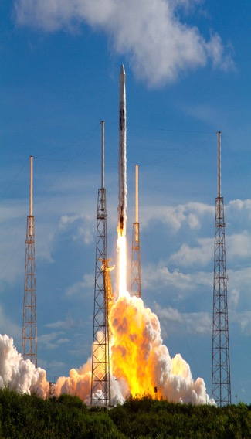
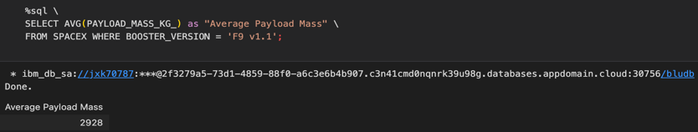
AVERAGE PAYLOAD MASS BY F9 V1.1
The Average Payload Mass:
SpaceX: 2,928 kg
The booster version F9 v1.1 had an average payload mass of 2,928 kg. This booster was a previous version of the Falcon 9 rocket, which is designed and manufactured by SpaceX to transport payloads to various orbits

Slide 29
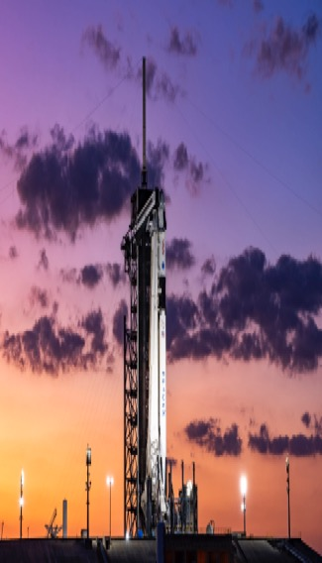
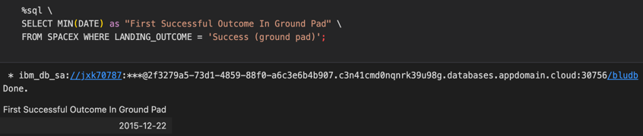
FIRST GROUND LANDING DATE
First Successful Landing On Ground Pad:
SpaceX made history on December 22nd, 2015, by achieving the first successful rocket landing on a ground pad, a significant milestone in the development of reusable rockets

Slide 30
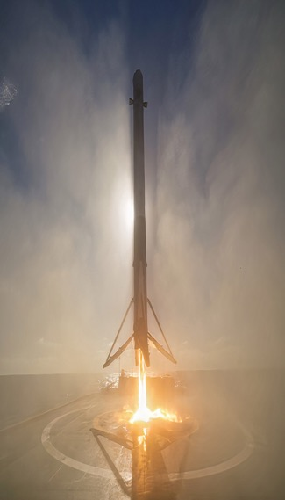
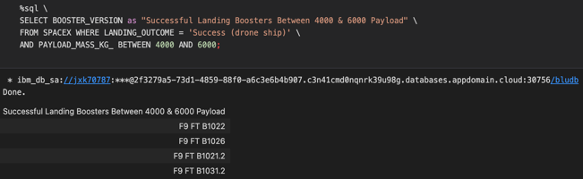
DRONE SHIP LANDING WITH PAYLOAD 4,000KG - 6,000KG
Booster Drone Ship Landing:
On December 22nd, 2015, SpaceX successfully landed a booster weighing between 4,000 and 6,000 kilograms on a drone ship, carrying payloads for JSCAT-14, JSCAT-16, SES-10, SES-11, and EchoStar 105 satellites

Slide 31
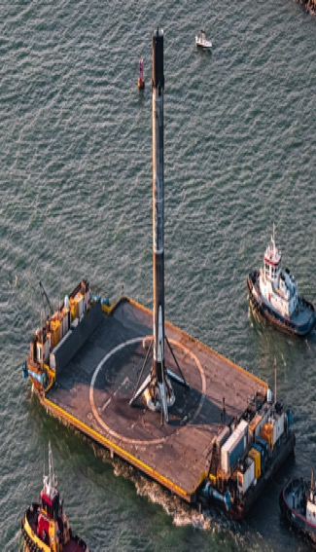
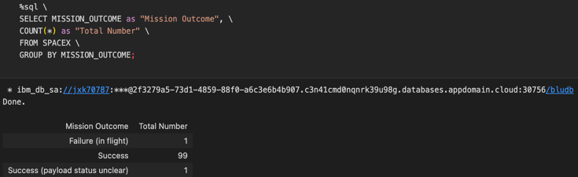
MISSION OUTCOMES: SUCCESS / FAILUER
Total Number Of Successful And Failed Mission Outcomes:
99 Successful Landings
1 Success (payload status unclear)
1 Failure In Flight

Slide 32
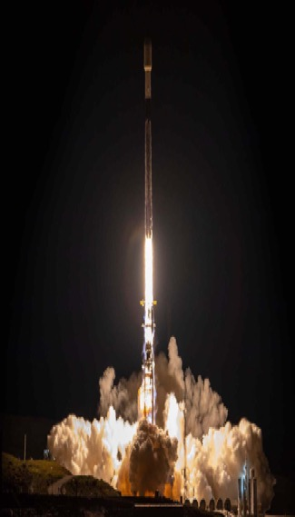
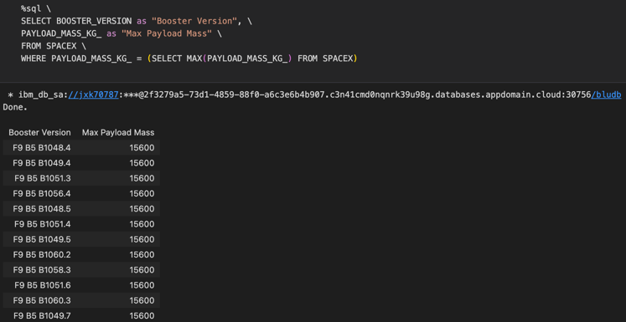
BOOSTERS CARRYING MAX PAYLOAD
Names of boosters which have max carrying payload mass using a subquery
SpaceX Falcon 9 Block 5 B1048.4
SpaceX Falcon 9 Block 5 B1049.4
SpaceX Falcon 9 Block 5 B1051.3
SpaceX Falcon 9 Block 5 B1056.4
SpaceX Falcon 9 Block 5 B1048.5
SpaceX Falcon 9 Block 5 B1051.4
SpaceX Falcon 9 Block 5 B1049.5
SpaceX Falcon 9 Block 5 B1060.2
SpaceX Falcon 9 Block 5 B1058.3
SpaceX Falcon 9 Block 5 B1051.6
SpaceX Falcon 9 Block 5 B1060.3
SpaceX Falcon 9 Block 5 B1049.7

Slide 33
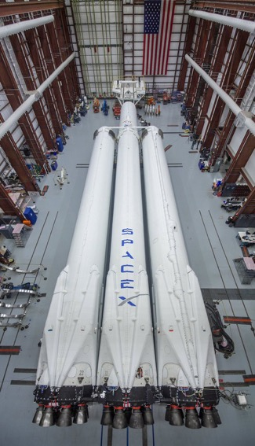

2015 LAUNCH RECORDS
Date / Booster Version
10-01-2015
F9 v1.1 B1012
14-04-2015
F9 v1.1 B1015
Launch Site
CCAFS LC-40
CCAFS LC-40
Landing Outcome
Failure (Drone Ship)
Failure (Drone Ship)

Slide 34


LANDING OUTCOMES 2010 - 2017
Success
20
No Attempt
10
The descending order of the count of landing outcomes recorded during the period spanning from June 4th, 2010 to March 20th, 2017 is to be presented
Success (Drone Ship)
8
Success (Ground Pad)
6
Failure (Drone Ship)
4
Failure
3
Controlled (Ocean)
3
Failure (Parachute)
2
No Attempt
1

Slide 35

LAUNCH SITE ANALYSIS

Slide 36


UNITED STATES LAUNCH SITE MAP
The proximity of a launch site to the equator is a crucial factor in optimizing the trajectory for launching a rocket to an equatorial orbit
The Earth's rotational speed provides an additional natural boost, enhancing the efficiency of launching a prograde orbit and achieving an equatorial orbit
Launching from sites situated closer to the equator can significantly reduce the cost associated with additional fuel consumption and the use of booster rockets to attain the desired orbit
Rockets launched from sites near the equator can take advantage of the natural boost provided by the Earth's rotation, thereby improving their overall performance and reducing operational costs

Slide 37


SITE LAUNCH RESULTS MAP
Successful launches are identified by green markers
Unsuccessful launches are denoted by red markers
Launch site CCAFS SLC-40 has a success rate of 3/7 (42.9%)

Slide 38


LAUNCH SITE PROXIMITIES MAP
Launch site CCAFS SLC-40 is 0.90km from the coast for easy transportation via waterways
Nearest railway is 21.96km away for minimal train traffic interference during launches
CCAFS SLC-40 is 23.23km from the nearest city for reduced noise and safety concerns while allowing easy access to the site
26.88km from the nearest highway to minimize vehicular traffic disruption during launches

Slide 39

PLOTLY DASHBOARD

Slide 40


SUCCESSFUL LAUNCH OF ALL SITES
The success rate of rocket launches is a critical performance metric for any launch site. Here are some insights about the "Success as a Percentage of Total" for various launch sites:
KSC LC-39A has the highest success rate at 41.2%, proving the team's technical expertise and operational excellence in safe launches.

Slide 41


HIGHEST SUCCESS LAUNCH SITE
KSC LC-39A had 10 successful launches out of 13, proving its ability for reliable and safe launches
KSC LC-39A has a success rate of 76.9%, showcasing its excellence in technical capabilities, safety protocols, and operational efficiency
Rocket launch success rates are critical for launch sites. See "Success as a Percentage of Total" for different sites:

Slide 42



PAYLOAD VS LAUNCH SCATTER PLOT
The analysis of rocket launches by booster version is a crucial exercise to gain insights into the performance and reliability of rocket boosters for different payload categories. Here are some observations related to the "By Booster Version" analysis:
Rocket launches by booster version indicate that payloads in the 2,000-5,000 kg range have the highest success rate, implying that the rocket boosters used for this payload category are the most reliable and efficient
The outcome of each rocket launch is indicated by a binary system, with 1 representing a successful outcome and 0 representing an unsuccessful outcome

Slide 43

PREDICTIVE ANALYSIS

Slide 44


CLASSIFICATION ACCURACY
The models exhibited comparable performance and accuracy, likely attributed to the limited dataset
However, the Decision Tree model demonstrated slightly better performance in terms of best score, which represents the mean score of all cross-validation folds for a particular parameter combination
 | LogReg | SVM | Tree | KNN
Jaccard Score | 0.800000 | 0.800000 | 0.800000 | 0.800000
F1 Score | 0.888889 | 0.888889 | 0.888889 | 0.888889
Accuracy | 0.833333 | 0.833333 | 0.833333 | 0.833333

Slide 45


CONFUSION MATRIX
Martix Equations
Performance Summary
Precision is calculated as TP / (TP + FP), yielding 12 / 15 = .80
Recall is calculated as TP / (TP + FN), yielding 12 / 12 = 1
F1 Score is calculated as 2 * (Precision * Recall) / (Precision + Recall), yielding 2 * (.8 * 1) / (.8 + 1) = .89
Accuracy is calculated as (TP + TN) / (TP + TN + FP + FN) = .833.
A confusion matrix provides a comprehensive summary of a classification algorithm's performance
All confusion matrices yielded identical results
The existence of false positives (Type 1 error) is not ideal.
Confusion Matrix Outputs: 12 True Positive, 3 True Negative, 3 False Positive, 0 False Negative

Slide 46

CONCLUSION
Launch Success
Improved technology and operations lead to more successful rocket launches
KSC LC-39A
KSC LC-39A has 100% success rate for launches under 5,500 kg, highlighting their excellence in technology and operations
Orbital Success
100% success rate for launches to ES-L1, GEO, HEO, and SSO orbits demonstrates excellent booster performance
Model Performance
Models had similar performance on the test set, with decision tree slightly better
Proximity to Equtor
Equatorial launch sites save fuel and booster costs due to the earth's rotational speed
Coastal Location
Launch sites near coasts ease component and personnel transportation
Payload
Mass
Higher payload masses correlate with higher success rates across launch sites

Slide 47

Recommendations
Increase dataset: Expand dataset and include alternative sources to improve accuracy and generalizability of findings
Evaluate feature analysis: Conduct additional feature analysis, like principal component analysis, to enhance model accuracy
Test XGBoost: Determine the effectiveness of the powerful XGBoost model, unexplored in this study, to outperform other models
Utilize location data: Utilize launch site location data to improve the accuracy of predictions for future launches
Continuously refine models: Update datasets and models regularly, apply them to new launches like Falcon Heavy and others, and explore new tools and models to stay up-to-date with computing developments and improve results

Slide 48

IBM
SPACEX
ROCKET
RESUABILITY

